Slide 1
Factory Method
Tomás Brás 112665
April 24th, 2024

Slide 2
When should we use this pattern?
The Factory Method is a creational design pattern that enables the creation of objects without specifying the exact class of the object that will be instantiated. It offers an interface that is implemented by child classes and allows object creation by a superclass.
This pattern is employed:
when there is a requirement to create multiple variations of objects or new types of products.
It achieves decoupling of the client code from concrete classes, enabling the client code to instantiate objects without the need to be aware of the concrete classes of the objects being created.

Slide 3
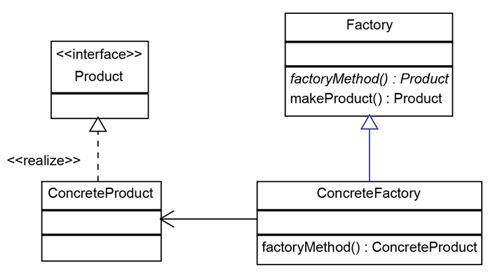
create a factory object that allows for the creation of new object types without using the new operator
How to implement this pattern?
Steps
Create an interface for creating objects in a superclass;
Create concrete classes implementing the same interface;
Create a factory class responsible for creating an object of a certain type, objects that implement the established interface in step 1;
Create a factory object that allows the creation of new object types without using the operator “new“;

Slide 4
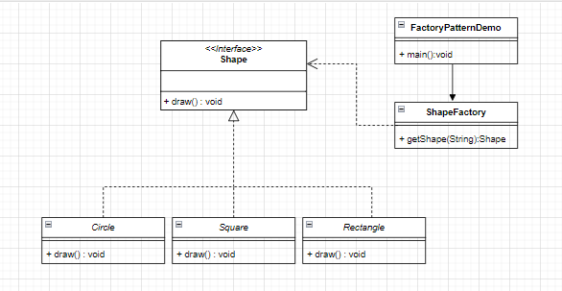
(Base) Class Structure

Slide 5
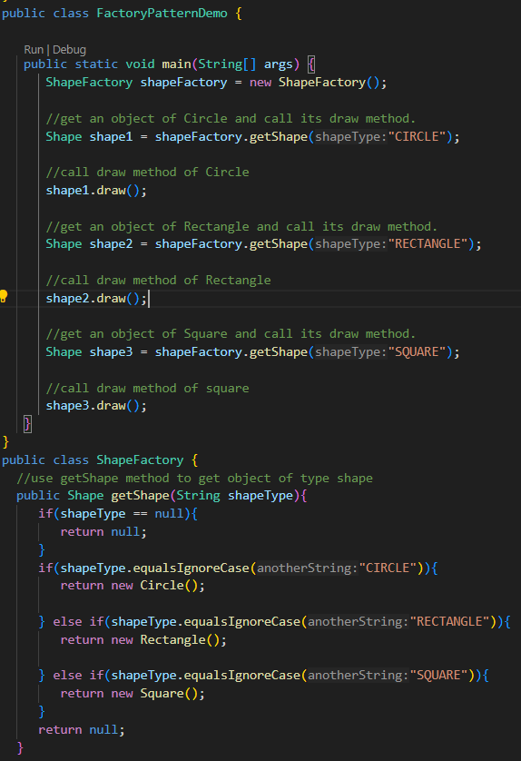
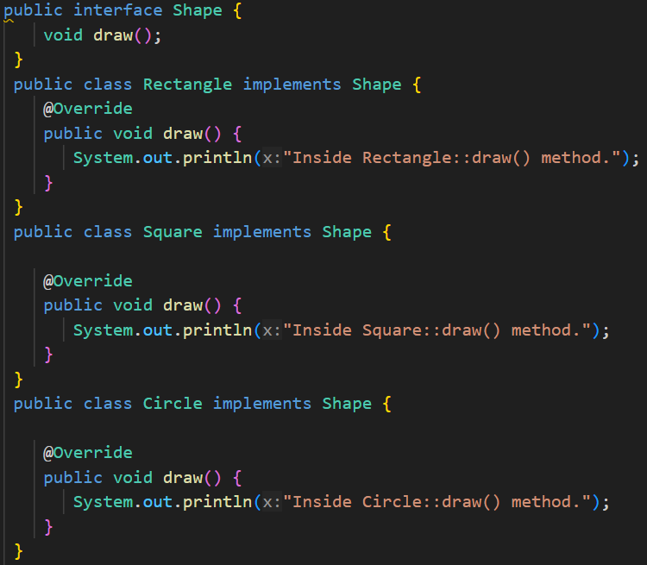
Code Example

